Slide 1
Module 1:
Introduction to Azure Concepts and Core Azure Services

Slide 2
Module 1: Lesson 5
Azure networking services fundamentals

Slide 3



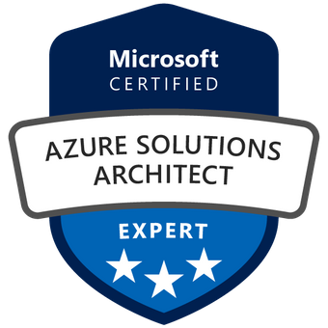
About The Presenter
Mohammed Adel
Senior Cloud Engineer / MAF Retail (Carrefour) / 15 years in the field
Microsoft Certified Azure Solution Architect
IT Operations and infrastructure background.
Hold other various certificates, MCP/MCSA/MCITP/CFDE

Slide 4
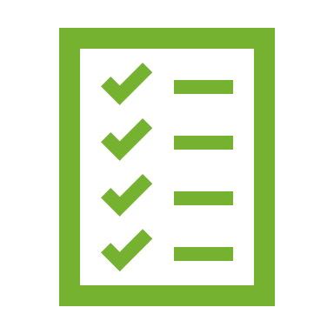

Lesson 5: Overview
This lesson will cover
Azure Virtual networks fundamentals
Azure VPN Gateway fundamentals
Azure ExpressRoute fundamentals
Notes:
We will take a look at several of the core networking resources that are available in Azure. And learn about Azure Virtual Network, which you can configure to meet your company's needs. We’ll also learn how to use Azure VPN Gateway and Azure ExpressRoute to create secure communication tunnels between your company's different locations.

Slide 5
Module 1: Lesson 5
What is Azure virtual networking?
Why we need Azure virtual networks?
Demo: Creating Azure virtual network
What is Azure VPN Gateway?
What is Azure ExpressRoute?
Notes:
We will define Azure virtual network and its capabilities, then we will watch a quick demo on how to create a virtual network, then we will move on to learn more about Azure VPN gateway and Azure ExpressRoute.

Slide 6
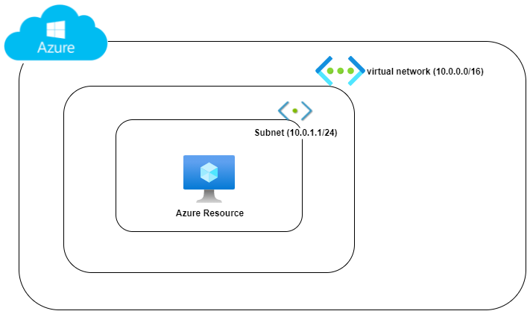
What is Azure virtual networking?
“Azure virtual networks enable Azure resources, such as VMs, web apps, and databases, to communicate with each other, with users on the internet, and with your on-premises client computers” - Microsoft.com
VNET: Virtual network.
Subnet: a segment of the virtual network.
CIDR address (10.0.0.0/16)
DNS: Domain name System, used for name resolution.
DHCP: Dynamic Host Configuration Protocol, used to assign dynamic IPs.
Gateway: used to connect two different networks.
Notes:
Azure virtual networks are very similar to regular networks that exist on data centers, and share the same function of connecting resources together.
In this picture we can see a simple view of how virtual network looks like in Azure,
virtual network address space, with one subnet taken from than space, it can have more than on subnet.
We should be familiar with basic networking terms such as VNET, Subnet, etc…
CIDR (Classless Inter-Domain Routing), method for allocating IP addresses and for IP routing
https://docs.microsoft.com/en-us/learn/modules/azure-networking-fundamentals/azure-virtual-network-fundamentals

Slide 7
Why we need Azure virtual networks?
Isolation and segmentation
Isolate your hosted workloads and multi-tier applications (frontend/backend).
Internet communications
Available by defaults to connected VMs.
You can enable incoming connections from the internet
VM management, Azure CLI, Remote Desktop Protocol, or Secure Shell.
Communicate between Azure resources
Service points such as (Azure SQL, storage accounts).
Other virtual networks.
Communicate with on-premises resources
Point-to-Site / Site-to-Site / ExpressRoute
Route network traffic
Route Table / Boarder Gateway Protocol (BGP)
Filter network traffic
Network Security Group (NSG) / Network Virtual Appliance (NVA)
Connect virtual networks
Peering
Notes:
Point-to-site virtual private networks The typical approach to a virtual private network (VPN) connection is from a computer outside your organization, back into your corporate network. In this case, the client computer initiates an encrypted VPN connection to connect that computer to the Azure virtual network.
Site-to-site virtual private networks A site-to-site VPN links your on-premises VPN device or gateway to the Azure VPN gateway in a virtual network. In effect, the devices in Azure can appear as being on the local network. The connection is encrypted and works over the internet.
Azure ExpressRoute For environments where you need greater bandwidth and even higher levels of security, Azure ExpressRoute is the best approach. ExpressRoute provides dedicated private connectivity to Azure that doesn't travel over the internet.
Route tables A route table allows you to define rules about how traffic should be directed. You can create custom route tables that control how packets are routed between subnets.
Border Gateway Protocol Border Gateway Protocol (BGP) works with Azure VPN gateways or ExpressRoute to propagate on-premises BGP routes to Azure virtual networks.
Network security groups A network security group is an Azure resource that can contain multiple inbound and outbound security rules. You can define these rules to allow or block traffic, based on factors such as source and destination IP address, port, and protocol.
Network virtual appliances A network virtual appliance is a specialized VM that can be compared to a hardened network appliance. A network virtual appliance carries out a particular network function, such as running a firewall or performing wide area network (WAN) optimization.
https://docs.microsoft.com/en-us/learn/modules/azure-networking-fundamentals/azure-virtual-network-fundamentals
Useful tools
https://www.davidc.net/sites/default/subnets/subnets.html
Other Notes:
Border Gateway Protocol (BGP) works with Azure VPN gateways or ExpressRoute to propagate on-premises BGP routes to Azure virtual networks.
Peering enables resources in each virtual network to communicate with each other.

Slide 8
Demo
Creating Azure Virtual Network
Notes:
https://docs.microsoft.com/en-us/learn/modules/azure-networking-fundamentals/azure-virtual-network-fundamentals
https://youtu.be/2g9gft2Zung

Slide 9
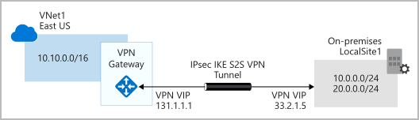
What is Azure VPN Gateway?
VPN: Virtual Private Network.
An encrypted tunnel between two or more trusted networks over untrusted network (internet).
Azure VPN Gateway is a type of virtual network gateway deployed in virtual network to enable the following:
Connect on-premises datacenters to virtual networks through a site-to-site connection.
Connect individual devices to virtual networks through a point-to-site connection.
Connect virtual networks to other virtual networks through a network-to-network connection
*Image source Microsoft.com
Notes:
Before we know what is Azure VPN Gateway, let us first define the VPN term.
https://docs.microsoft.com/en-us/learn/modules/azure-networking-fundamentals/azure-vpn-gateway-fundamentals

Slide 10
What is Azure VPN Gateway?
Only one VPN Gateway can exist in a VNET, but it can be used to connect multiple locations (other VNETs / On-premises).
VPN type: either policy-based or route-based
Both types rely on Internet Key Exchange (IKE) and Internet Protocol Security (IPSec) and use a pre-shared key to authenticate.
IKE is used to set up a security association (an agreement of the encryption) between two endpoints. This association is then passed to the IPSec suite, which encrypts and decrypts data packets encapsulated in the VPN tunnel.
Policy-based: specify statically the IP address of packets that should be encrypted through each tunnel.
Route-based: IPSec tunnels are modeled as a network interface or virtual tunnel interface.
Notes:
https://docs.microsoft.com/en-us/learn/modules/azure-networking-fundamentals/azure-vpn-gateway-fundamentals
VPN Types details: https://docs.microsoft.com/en-us/azure/vpn-gateway/vpn-gateway-connect-multiple-policybased-rm-ps

Slide 11
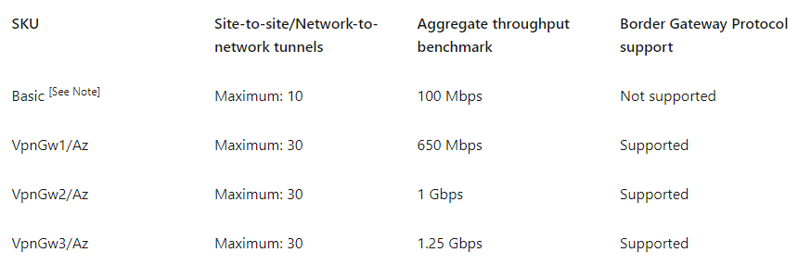
What is Azure VPN Gateway?
VPN Gateways comes in different sizes and capabilities
*Image source Microsoft.com
Notes:
https://docs.microsoft.com/en-us/learn/modules/azure-networking-fundamentals/azure-vpn-gateway-fundamentals

Slide 12
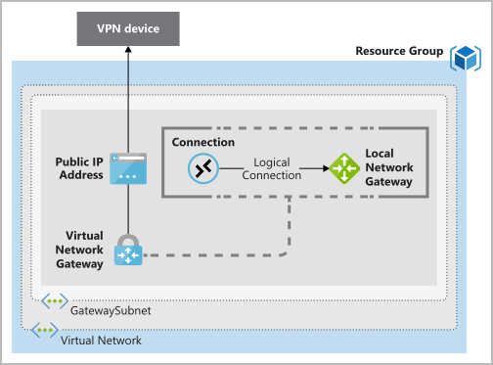
What is Azure VPN Gateway?
To deploy a VPN Gateway, you will need the following resources
On Azure
Virtual Network
GatewaySubnet
Public IP Address
Local Network Gateway
Virtual Network Gateway
Connection
On-Premises
A VPN device that support both VPN Types.
A Public-facing IP address (IPv4).
*Image source Microsoft.com
Notes:
https://docs.microsoft.com/en-us/learn/modules/azure-networking-fundamentals/azure-vpn-gateway-fundamentals
Local network gateway. Create a local network gateway to define the on-premises network's configuration, such as where the VPN gateway will connect and what it will connect to. This configuration includes the on-premises VPN device's public IPv4 address and the on-premises routable networks. This information is used by the VPN gateway to route packets that are destined for on-premises networks through the IPSec tunnel.

Slide 13
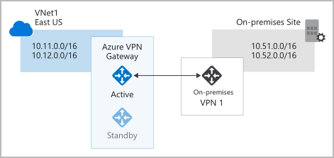
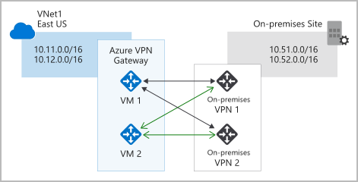
What is Azure VPN Gateway?
High Availability (HA) supported scenarios
Active / Standby
Active / Active
ExpressRoute failover
Zone-redundant gateways
*Image source Microsoft.com
Notes:
Active/standby
By default, VPN gateways are deployed as two instances in an active/standby configuration, even if you only see one VPN gateway resource in Azure.
Active/active
With the support of the BGP routing protocol, you can also deploy VPN gateways in an active/active configuration. In this configuration, you assign a unique public IP address to each instance. You then create separate tunnels from the on-premises device to each IP address.
ExpressRoute failover
Another high-availability option is to configure a VPN gateway as a secure failover path for ExpressRoute connections. ExpressRoute circuits have resiliency built in. But they aren't immune to physical problems that affect the cables delivering connectivity or outages that affect the complete ExpressRoute location. In high-availability scenarios, where there's risk associated with an outage of an ExpressRoute circuit, you can also provision a VPN gateway that uses the internet as an alternative method of connectivity. In this way, you can ensure there's always a connection to the virtual networks.
Zone-redundant gateways
In regions that support availability zones, VPN gateways and ExpressRoute gateways can be deployed in a zone-redundant configuration. This configuration brings resiliency, scalability, and higher availability to virtual network gateways. Deploying gateways in Azure availability zones physically and logically separates gateways within a region while protecting your on-premises network connectivity to Azure from zone-level failures. These gateways require different gateway SKUs and use Standard public IP addresses instead of Basic public IP addresses.
https://docs.microsoft.com/en-us/learn/modules/azure-networking-fundamentals/azure-vpn-gateway-fundamentals

Slide 14
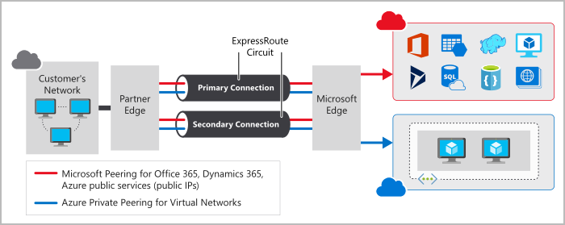
What is Azure ExpressRoute?
“ExpressRoute lets you extend your on-premises networks into the Microsoft cloud over a private connection with the help of a connectivity provider.” – Microsoft.com
*Image source Microsoft.com
Notes:
ExpressRoute connections don't go over the public Internet. This allows ExpressRoute connections to offer more reliability, faster speeds, consistent latencies, and higher security than typical connections over the Internet.
https://docs.microsoft.com/en-us/learn/modules/azure-networking-fundamentals/express-route-fundamentals

Slide 15
What is Azure ExpressRoute?
Why we need ExpressRoute
Layer 3 connectivity between your on-premises network and the Microsoft Cloud through a connectivity provider across all regions.
Dynamic routing between your network and Microsoft via BGP.
Built-in redundancy in every peering location for higher reliability.
Connection uptime SLA.
Notes:
Layer 3 (L3): This layer is the Network Layer, which provides addressing and routing between nodes on a multi-node network.
ExpressRoute uses the Border Gateway Protocol (BGP) routing protocol. BGP is used to exchange routes between on-premises networks and resources running in Azure
https://docs.microsoft.com/en-us/learn/modules/azure-networking-fundamentals/express-route-fundamentals

Slide 16




Prepare for The Exam (Q/A)
How can you connect two separate Azure VNETs?
Domain Naming Systems
ExpressRoute
VNET Peering
ExpressRoute is used to ……
Provide a redundant Connectivity between On-Premises and Microsoft Cloud Services
Connecting on-premises networks to Azure different regions.
All of the Above

Slide 17
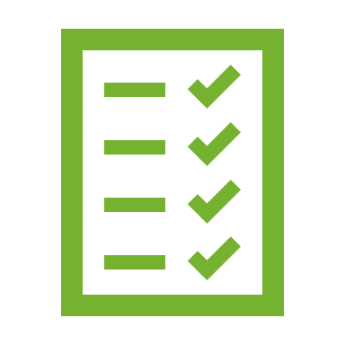
Summary
This lesson has covered
Azure Virtual networks
Azure Virtual VPN Gateway
Azure ExpressRoute
Notes:
How Cloud Can Help DevOps Transformation

